Slide 1
Health Care DWH Integration
DEPI Final Project

Slide 2
overview
Introduction Overview of the Healthcare Data Warehouse Integration project.
Technologies and Tools: SSIS and SQL for ETL processes and data integration
Python for Exploratory Data Analysis (EDA) and machine learning
Azure Synapse for cloud data warehousing
Power BI for data visualization and reporting
Streamlit for model deployment
3. Data Sources and Integration
Data collection from CSV files related to diabetes, stroke, and heart disease
SSIS for extracting, transforming, and loading (ETL) into SQL Server
4. Exploratory Data Analysis (EDA)
Implementing EDA on each disease dataset using Python
Visualizing patterns and trends in the data

Slide 3
overview
5. Machine Learning Implementation
Building predictive models for each disease (diabetes, stroke, heart disease)
Using logistic regression, SVM and KNN for classification
6. Azure Synapse Integration Storing and processing data in Azure Synapse
Integrating machine learning models within the cloud environment
Power BI Analysis: Developing dashboards for visual analysis of disease trends
Providing insights for decision-making in healthcare
8. Model Deployment with Streamlit
Deploying machine learning models to predict disease
Interactive web app for users to input data and get predictions

Slide 4
The goal of this project is to create an end-to-end data engineering pipeline that collects, processes, and analyzes data related to three major diseases: brain stroke, heart disease, and diabetes. The project involves gathering datasets for these diseases from various sources, cleaning and transforming the data to ensure consistency, and storing it in a well-architected data warehouse. Once the data is processed, the next phase focuses on building a machine learning model to predict the likelihood of a user having one of these diseases based on relevant health metrics. This predictive model will leverage historical data to train and test the model, providing valuable insights for early diagnosis and risk assessment. The final deliverables will include a fully operational pipeline, a trained machine learning model, and a comprehensive dashboard or reporting system to visualize the predictions and data insights, making the solution both scalable and actionable for real-world applications.
Introduction

Slide 5
Chronic diseases like diabetes, stroke, and heart disease are leading causes of death globally. Effective prevention and early detection can reduce healthcare costs and improve patient outcomes. However, healthcare systems often face challenges in integrating large volumes of data from different sources to provide real-time insights. The goal of this project is to create an end-to-end data engineering pipeline that collects, processes, and analyzes data related to three major diseases: brain stroke, heart disease, and diabetes. The project involves gathering datasets for these diseases from various sources, cleaning and transforming the data to ensure consistency, and storing it in a well-architected data warehouse.
overview

Slide 6
Once the data is processed, the next phase focuses on building a machine learning model to predict the likelihood of a user having one of these diseases based on relevant health metrics. This predictive model will leverage historical data to train and test the model, providing valuable insights for early diagnosis and risk assessment. The final deliverables will include a fully operational pipeline, a trained machine learning model, and a comprehensive dashboard or reporting system to visualize the predictions and data insights, making the solution both scalable and actionable for real-world applications.
overview

Slide 7
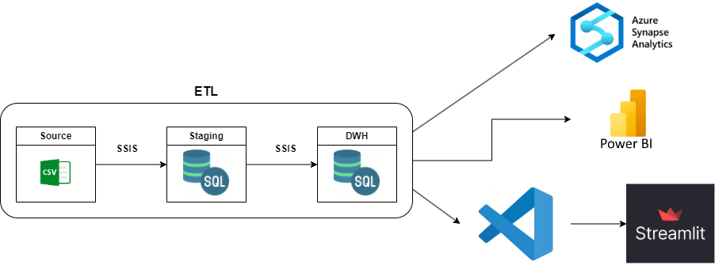
Data Flow

Slide 8
Prepare data
Collecting data and cleaning

Slide 9
We are going to collect data about the 3 diseases brain stroke, heart disease, and diabetes from multiple sources and connect them to one destination using SSIS for the ease of the EDA and saving time instead of working in each one of them separated. After cleaning the files on jupyter we are going to use the SSIS again in the following: 1- creating Staging area 2- creating DWH area 3- creating Dimension tables 4- creating Fact table
SSIS

Slide 10
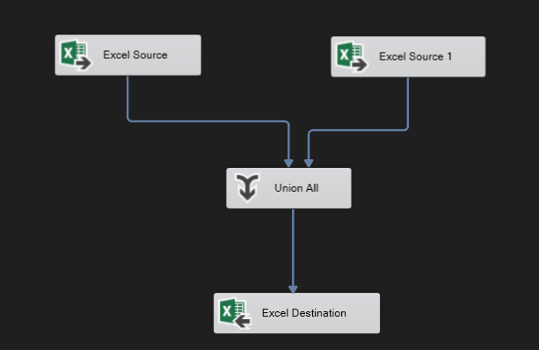
Here we have 2 files for both diabetes and heart , and 1 file for brain stroke we connect the source with the path of files using connection and connect the output to the destination which are new csv files with all the data in 1 file for each disease
SSIS

Slide 11
After creating the files with all data we import them to jupyter and start to work in each file alone. In jupyter we need to : 1 – clean data : form nulls and duplication 2 – EDA : ask question and create insights . 3 – ML : create model for each disease .
python

Slide 12
Brain Stroke
Collecting data

Slide 13
Brain Stroke
First we need to know columns in this data set :
Gender – Age hypertension – ever_married– Residence_type– BMI work_type – blood_glucose_level – smoking_status – Stroke (target)
After cleaning data from nulls and duplications using dropna() and drop_duplicates, we create EDA in jupyter

Slide 14
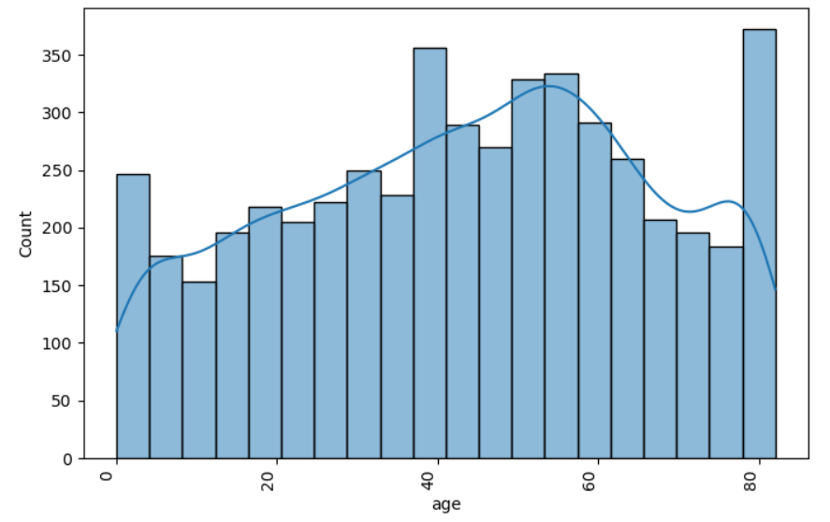
Brain Stroke
Here we wanted to show the age distribution in this data set and their count

Slide 15
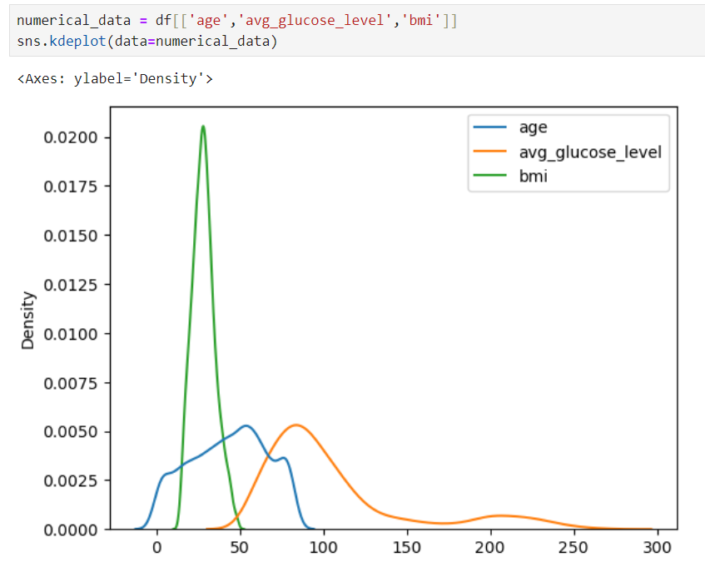
Brain Stroke
Show the density of age , average glocuse level and BMI in the dataset

Slide 16
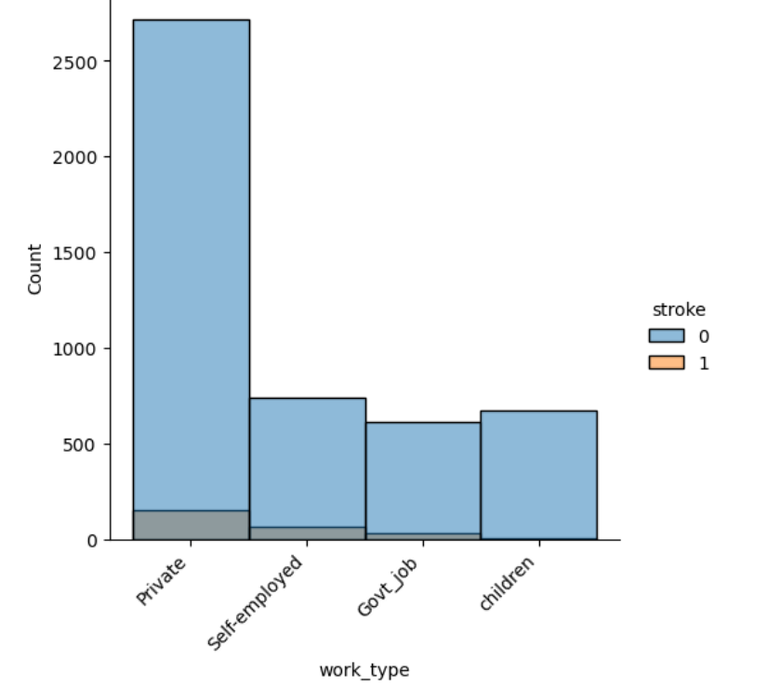
Brain Stroke
The count of work type of people who had stroke against not

Slide 17
Diabetes
Collecting data

Slide 18
Diabetes
First we need to know columns in this data set :
Gender – Age hypertension – heart_disease – smoking_history – BMI HbA1c_level – blood_glucose_level – diabetes(trarget)
Them we run the code of cleaning to drop nulls and duplicated rows
We use matplotlip and seaborn libraries to create visualization

Slide 19
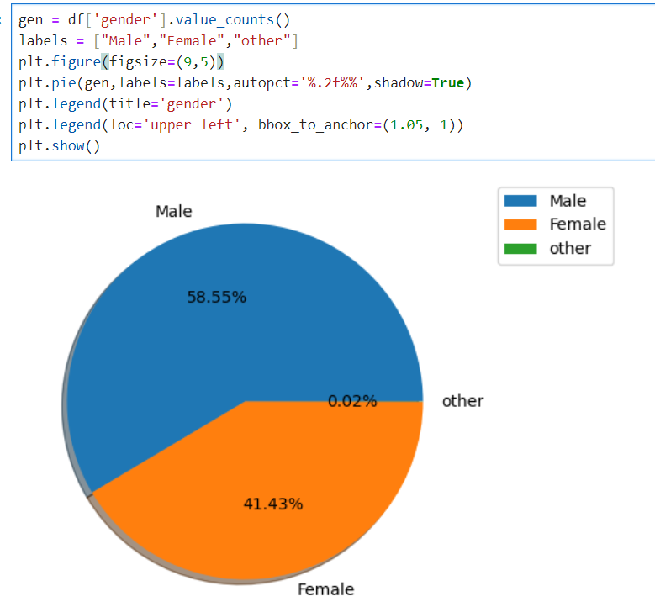
Diabetes
Here we wanted to show the gender of the participation in this data set

Slide 20
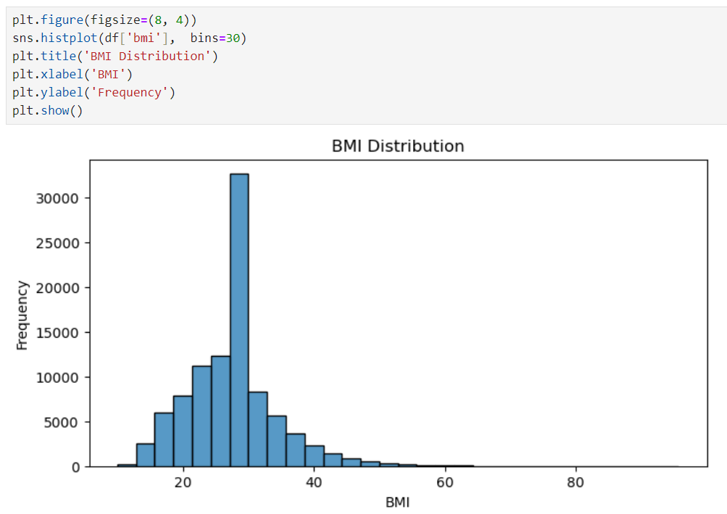
Diabetes
Here we wanted to show the BMI distribution in the dataset .
We used hist plot and more bins = 30 but the distribution appear to stop at 65

Slide 21
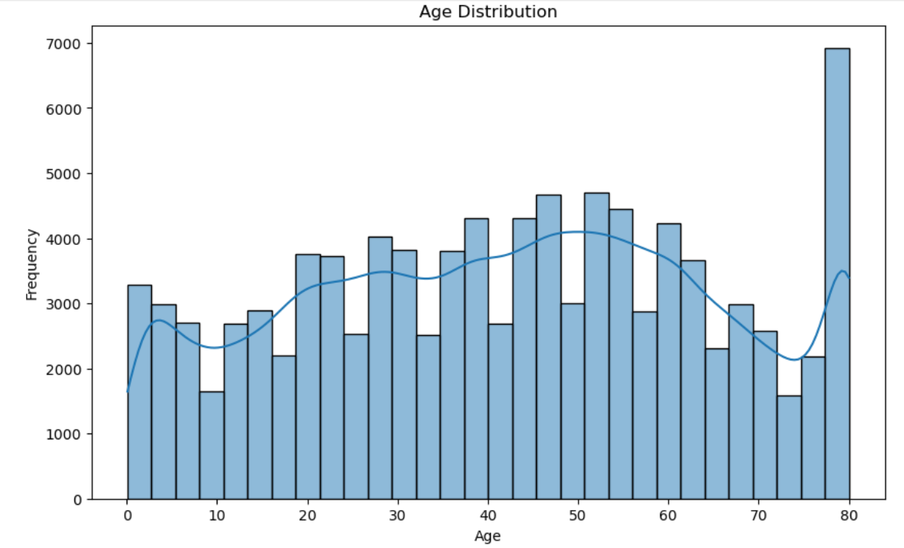
Diabetes
Here we wanted to show the Age distribution in the dataset .
We used hist plot and make kde = true to view variation line in data .

Slide 22
Heart
Collecting data

Slide 23
Heart
First we need to know columns in this data set :
HeartDisease (target) – BMI - AlcoholDrinking – Smoking – MentalHealth – PhysicalHealth – DiffWalking – AgeCategory – Sex – Race – Diabetic – PhysicalActivity – GenHealth – SleepTime – Asthma KidneyDisease – SkinCancer
Them we run the code of cleaning to drop nulls and duplicated rows
We use matplotlip and seaborn libraries to create visualization

Slide 24
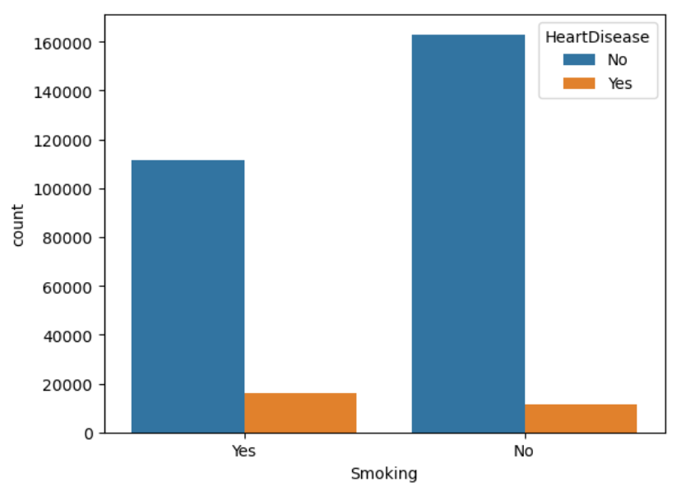
Heart
Here we wanted to show if smoking is related to having heart disease or not

Slide 25
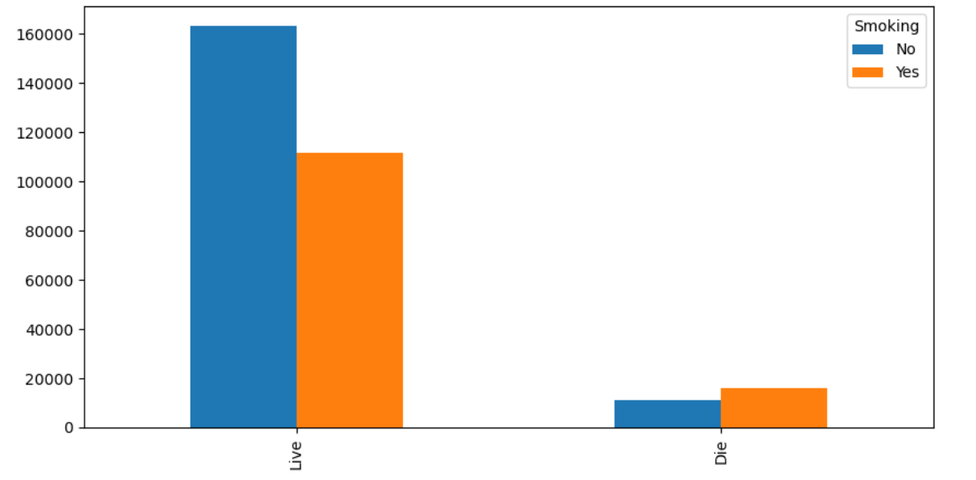
Heart
Here seams that smoking is not the main reason of dyeing if having heart diseases
In code there are some visualization but for alcohol drinking and skin cancer

Slide 26
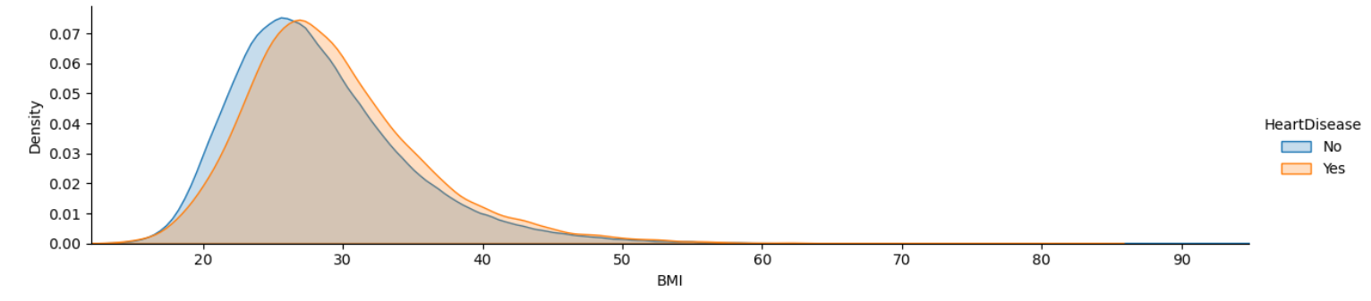
Heart
Using facetgrid to show the density of BMI in data

Slide 27
Staging and Data Warehouse

Slide 28
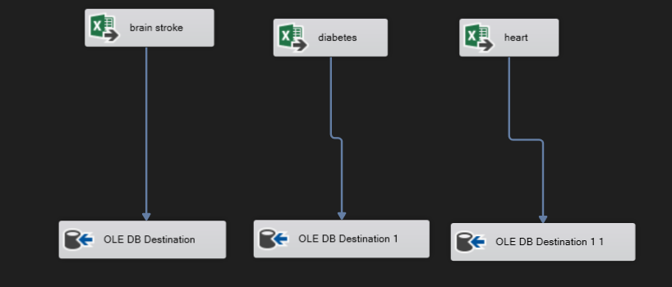
Preparing for staging
Finally we must export our data from the 3 data set after cleaning to be used in SSIS and SQL .
Our goal is to create staging database which is the database before DWH using SQL and export these files in the sql databas

Slide 29
Preparing for DWH
After creating our staging database we need
to choose what exactly are going to be used
in data warehouse from staging and to do that we
need to go back to jupyter to find the
correlation between columns and target and if correlation is small we will drop that column to reduce the number of columns as possible.
To make sure we didn’t destroy the data we can use the same ML mode to see what have changed in accuracy

Slide 30
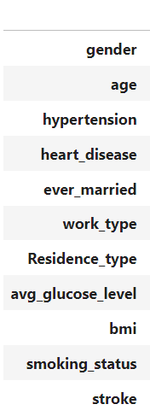
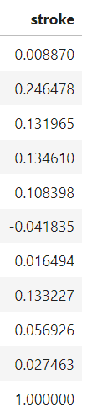
Brain stroke
Here we can find that gender, residence type and work type have low correlation and can be removed
Now we need to go and make ML model and we will find that accuracy is almost same (83%)
Now export the new csv file of this disease and to be used in SSIS as Dimension table

Slide 31
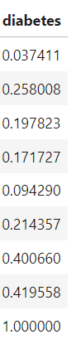
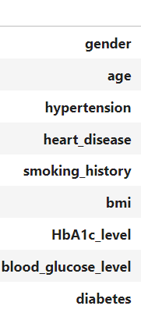
Diabetes
Here we can find that gender have low correlation and can be removed
Now we need to go and make ML model and we will find that accuracy is almost the same (81%)
Now export the new csv file of this disease and to be used in SSIS as Dimension table

Slide 32
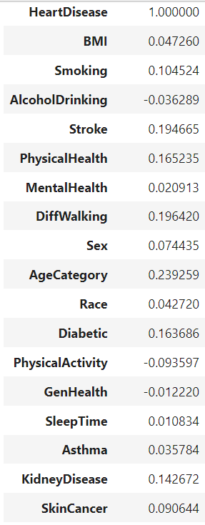
Heart
Here we can find that alcohol drink , mental health , sex, Race, genhealth, sleeptime, asthma and skin cancer have low correlation and can be removed
Now we need to go and make ML model and we will find that accuracy decreased by little (88.7%)
Now export the new csv file of this disease and to be used in SSIS as Dimension table

Slide 33
Preparing for DWH
Finally we create dimension table for each disease using SQL and use SSIS to put the the data form the CSV file to SQL file in the staging database in MS SQL
Now we need to figure out the content of the Fact table which will be feed for the dimension tables, which rows and column will be used in it
So we will jump to the next part which is
Creating Fact table

Slide 34
Preparing for Fact table
We noticed that all tables share common columns like AGE , BMI, Heart disease and smoking type
Also few columns are common but for 2 tables
Like hypertension and glucose level are in diabetes and brain stroke table
So we can use this columns in the fact table beside columns with very high correlation to each disease

Slide 35
Preparing for Fact table
The problem is that columns like smoking type is same info but in different format so we need to set this columns in all tables to be in same format and then use SSIS to import to fact table in DWH

Slide 36
Preparing for Fact table
In brain stroke table we won’t change format of the 4 common columns and we will use them as the main format for other tables.
In heart table we will map some values to be match with common columns values in other table.
And In age category we will use the first number only to match age column in other tables using str.extract

Slide 37
Preparing for Fact table
In diabetes, we found that smoking_history column has ['never', 'No Info', 'current', 'former', 'ever', 'not current’] as unique values.
So we will drop rows ['ever’ or current’] values in it
And replace values to others like
('No Info', 'Unknown’), ('former', 'formerly smoked’), ('current', 'smokes’), ('never', 'never smoked’)

Slide 38
Azure

Slide 39
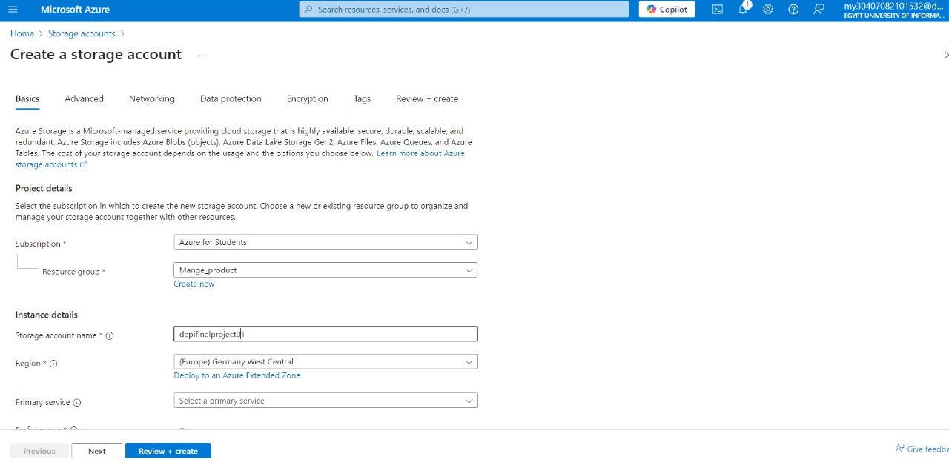
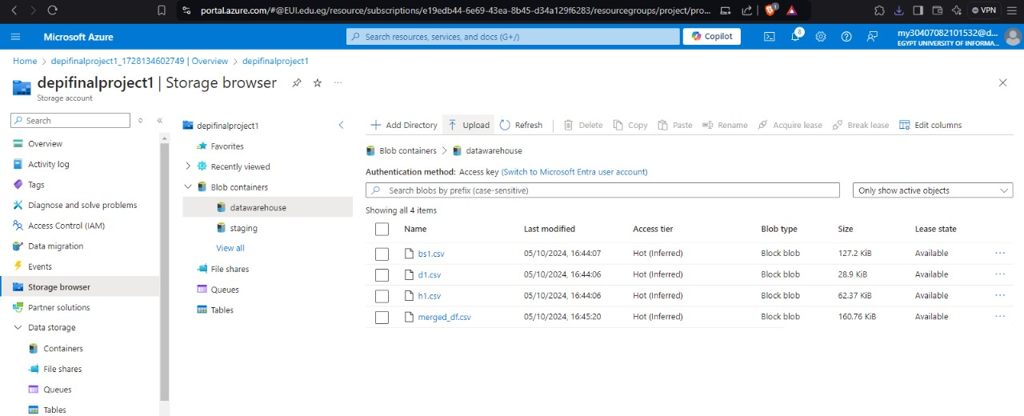
Azure Storage Creation
In Azure we created 2 data storage one for staging and the other for DWH.
Then we upload the dimension tables and Fact table in the data storage.

Slide 40
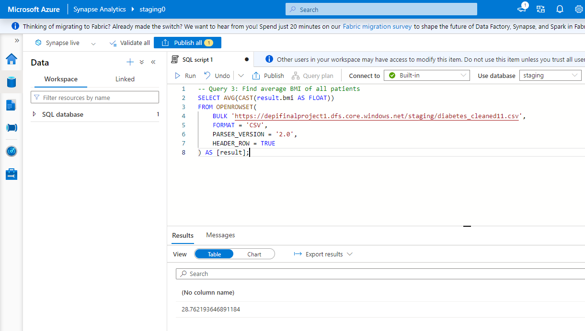
Queries on staging tables
This SQL query calculates the average BMI of all patients in the dataset. The AVG function computes the mean of these BMI values, and the result is cast to FLOAT for precision

Slide 41
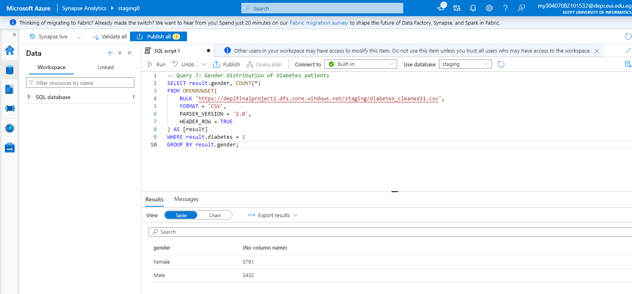
Queries on staging tables
This query extracts all the gender fields from the date set and groups by gender and counts the number of rows associated with each value for gender

Slide 42
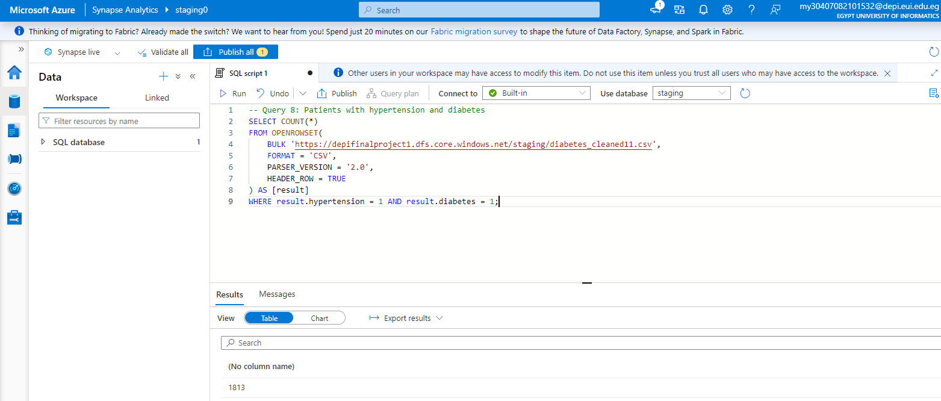
Queries on staging tables
This query extracts all the hypertension and diabetes fields from the dataset and returns count of rows where both columns equals 1

Slide 43
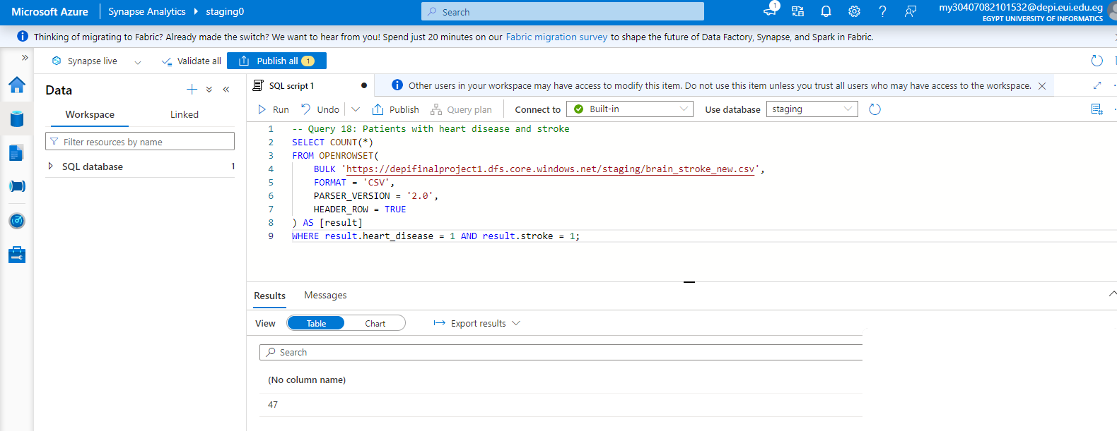
Queries on staging tables
This SQL query counts the number of patients who have both heart disease and stroke. It uses OPENROWSET to access the data source, and to extract the 'heart_disease' and 'stroke' fields from each row. The COUNT function tallies the rows where both 'heart_disease' and 'stroke' values equal 1, indicating patients who have both conditions.

Slide 44
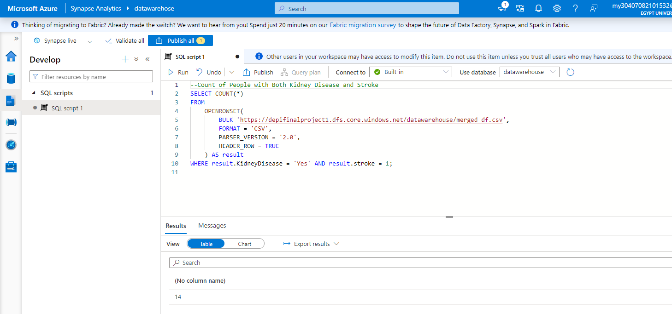
Queries on staging tables
The SQL query in the image counts the number of people who have both kidney disease (where kidney disease equals "Yes") and have had a stroke (where stroke equals 1) from a CSV file stored in Azure Blob Storage, it filters rows that meet both conditions. The result shows that there are 14 people with both kidney disease and a history of stroke.

Slide 45
Power BI

Slide 46
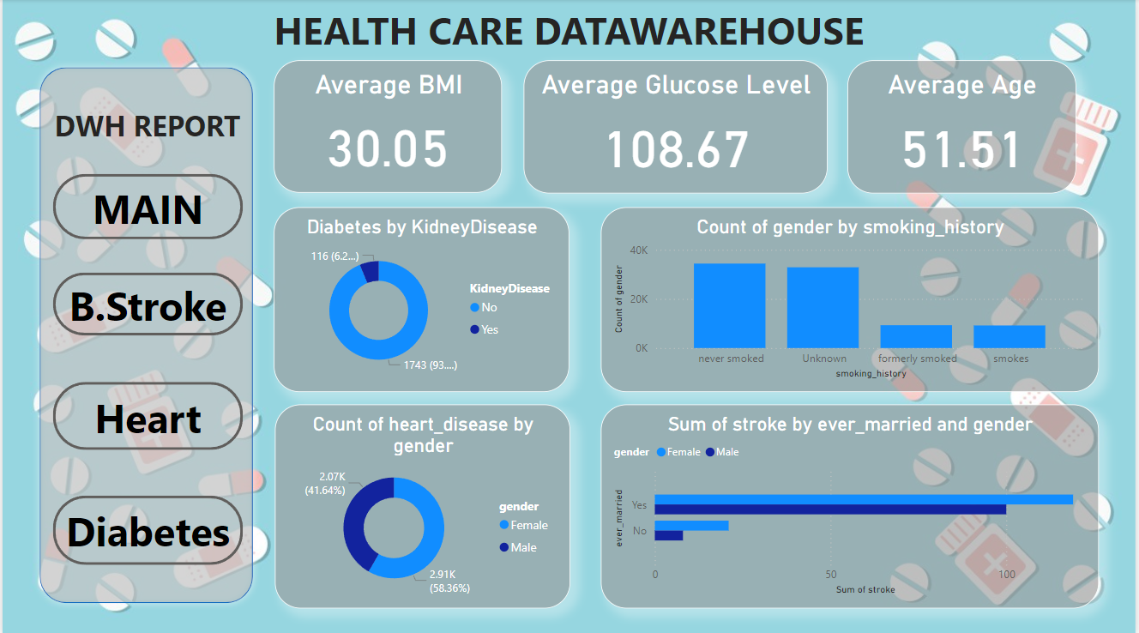
Power BI
Main page
Contains
data form
the fact table

Slide 47
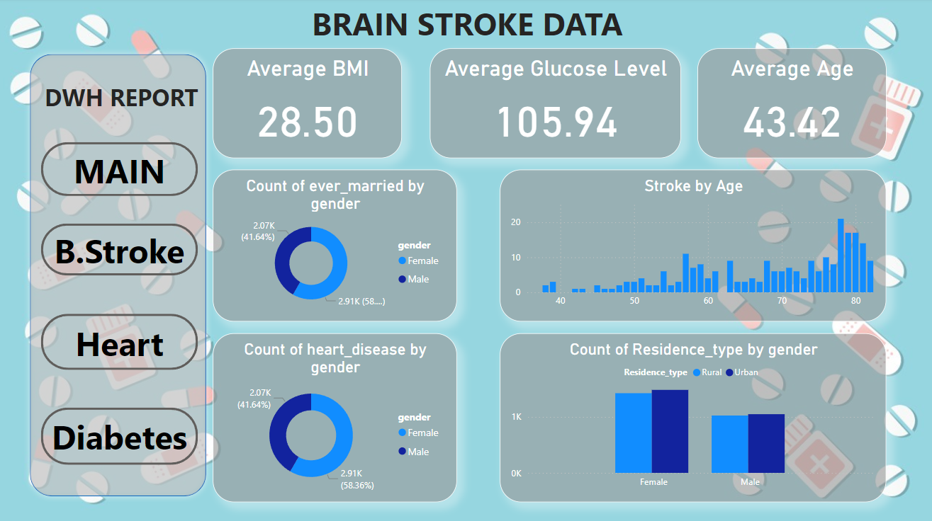
Power BI
Contains
data form
the brain
Stroke
Dimension
table

Slide 48
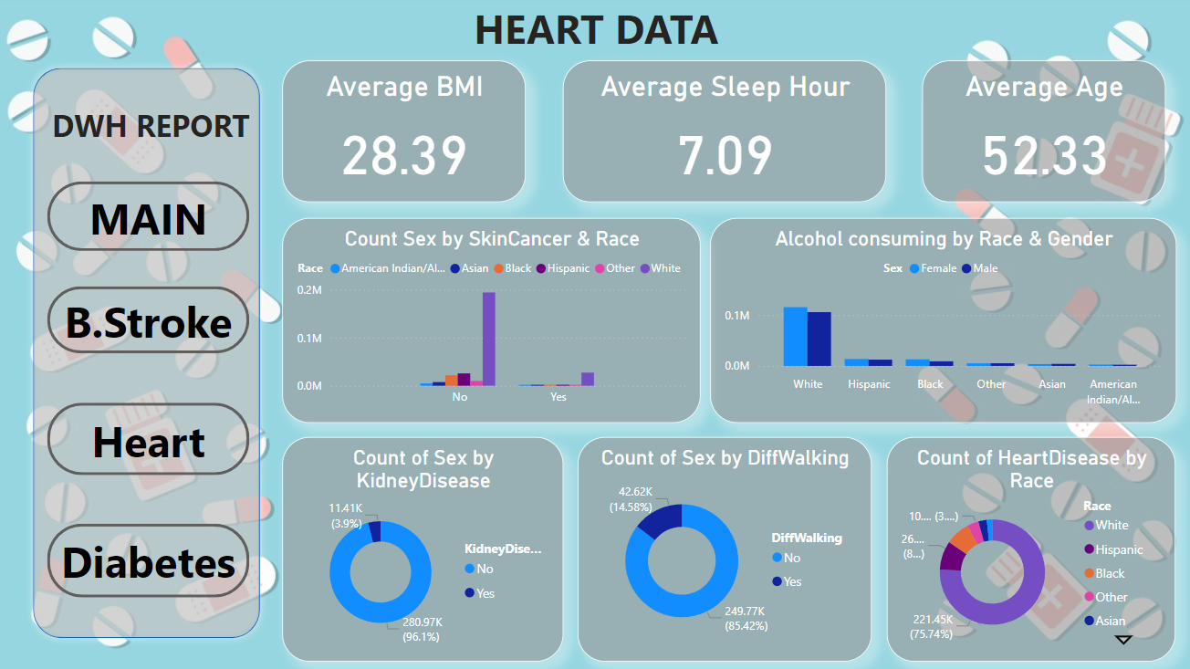
Power BI
Contains
data form
the Heart
Dimension
table

Slide 49
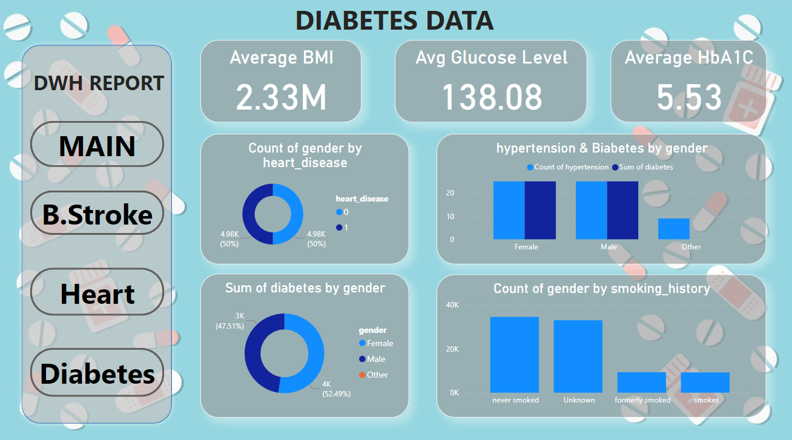
Power BI
Contains
data form
the Diabetes
Dimension
table

Slide 50
Machine Learning

Slide 51
Machine Learning
Algorithms used in models:
StandardScaler
OneHotEncoder
ColumnTransformer
Pipeline
param_grid
grid_search
roc_curve
Models used in models:
Logistic Regression
KNN
SVM
Random Forest

Slide 52
Machine Learning
After implementing the ML models in each disease, we found that:
Brain stroke : KNN
Diabetes and Heart : Random Forest

Slide 53
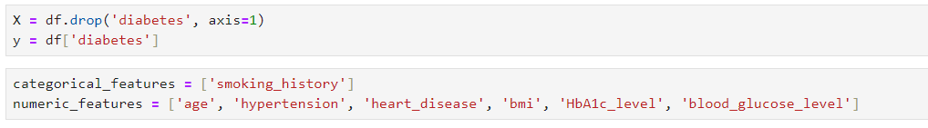
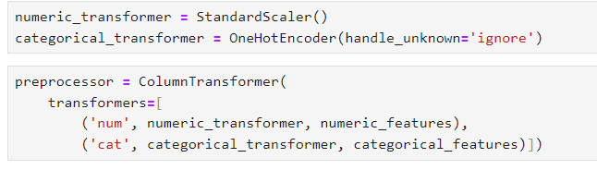
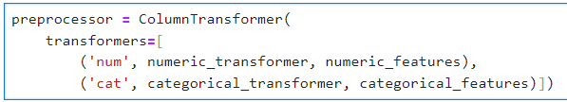
Machine Learning
For example in Diabetes:
We split data to features and target.
Then create categorical_features
and numeric_features.
For numeric_features, we used
standardscaler for scaling data and
used One hot encoder for
categorical_features.
The preprocessor to handle data
the transformation task with the
numerical and categorical variables

Slide 54
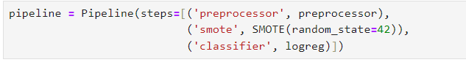
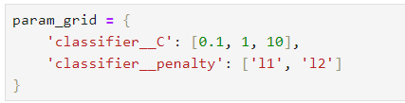
Machine Learning
For example in Diabetes:
We used pipeline to ensures that all
steps are executed consistently and
simplifies the process of
transforming data
Param_grid defines the
hyperparameters and
their values for which we
want to optimize the machine
learning model using

Slide 55
Streamlit

Slide 56
Overview
Streamlit
is an open-source library for building interactive web applications quickly and easily, primarily for data analysis and machine learning projects. It allows you to convert simple Python scripts into elegant web apps without needing deep knowledge of web technologies like HTML or CSS.
Key Features:
Ease of Use: Write simple Python code to create interactive applications.
Interactivity: Supports UI elements like buttons, sliders, and input fields for user interaction.
Instant Updates: Automatically refreshes the app when you change the code.

Slide 57
Overview
Libraries used in project :
import pandas as pd
import numpy as np
from sklearn.model_selection import train_test_split
from sklearn.ensemble import RandomForestClassifier
from sklearn.metrics import accuracy_score
from sklearn.preprocessing import LabelEncoder
from sklearn.exceptions import NotFittedError

Slide 58
Overview
Funcation used in my project
1. load_data(name)
What it does: Loads a dataset based on what the user selects.
Key Point: Reads a CSV file.
2. preprocess_data(df)
What it does: Prepares the data for the model.
Key Point: Cleans the data and converts categories to numbers

Slide 59
Overview
3. train_model(X, y)
What it does: Trains the machine learning model.
Key Point: Splits data, fits the model, and checks its accuracy.
4. Prediction Block (after user submits)
What it does: Takes user input and predicts the result.
Key Point: Prepares input data and shows whether the user is "Infected" or "Not Infected."

Slide 60
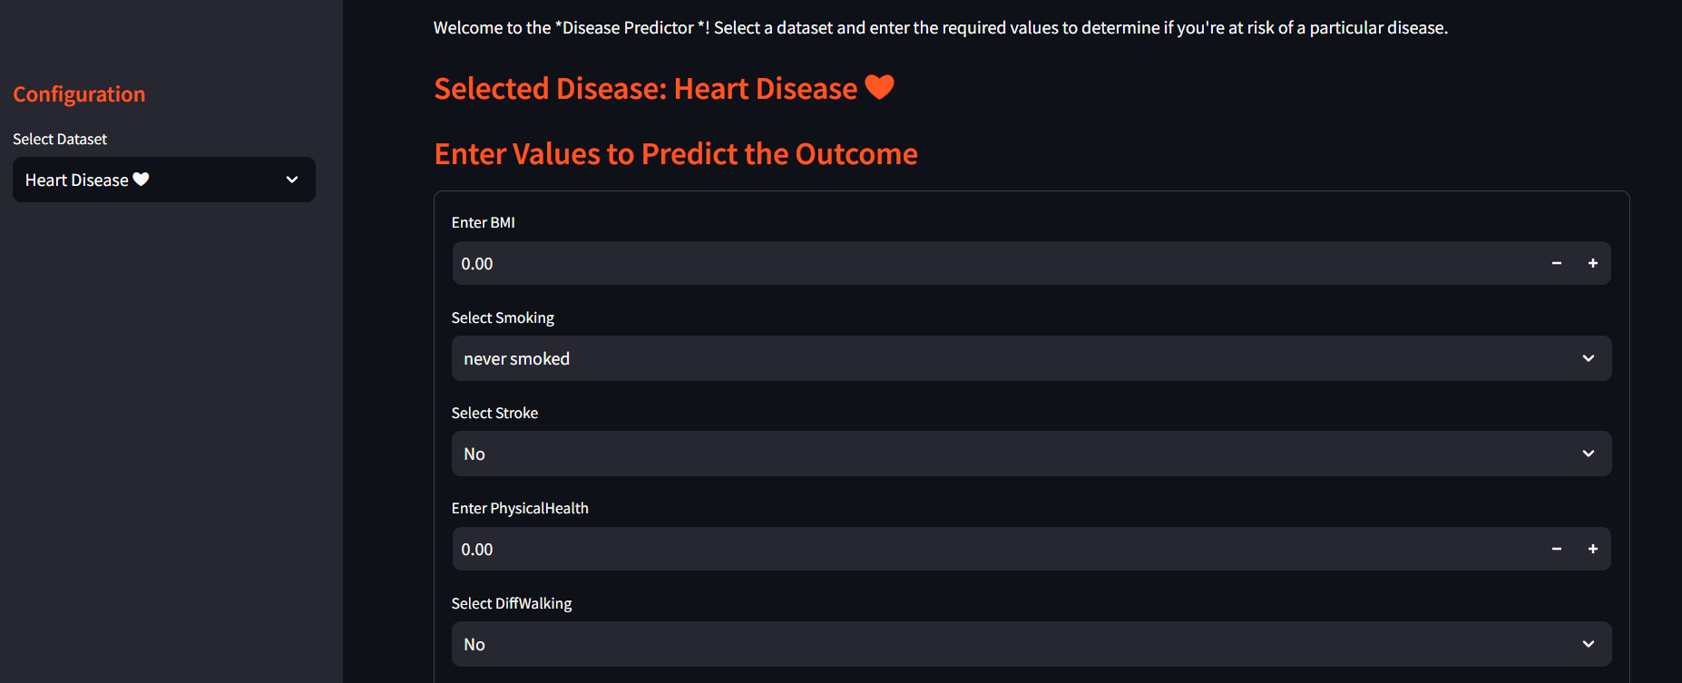
Streamlit
After selecting the dataset of the disease, you will be required to enter your data and the model will predict your statues of the disease

Slide 61
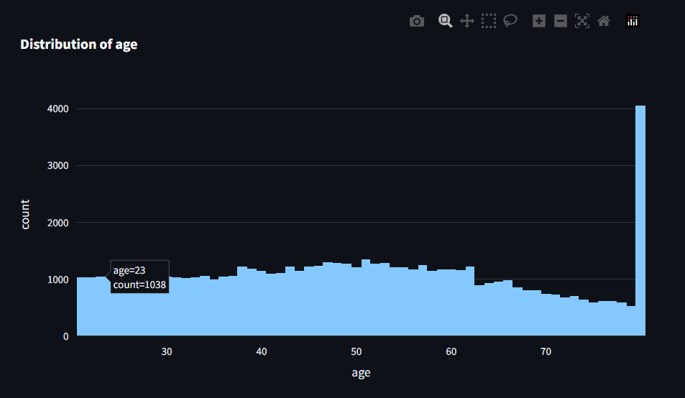
Streamlit
You can see some insights about the data if you like

Slide 62
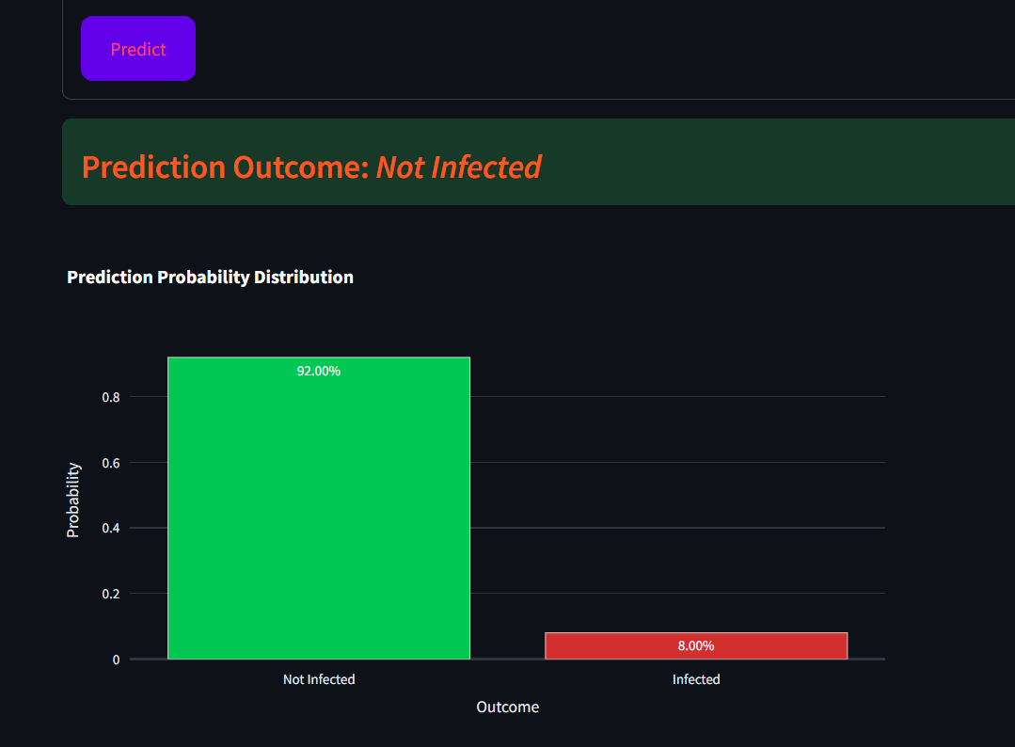
Streamlit
The model will also give you the percentage of having the disease or not by using predict probability

Slide 63
Thanks
Do you have any questions?
Khaled Ayman Farouk
Matyas Monir Yousef Eskander
Noor Eldeen Mohammed Shrief
Mostafa Rabea Hashem

